Slide 1

An Introduction to
Resource Sharing:
One Click Away From a World of Resources
By: Kia Grant

Slide 2

01
What is Resource Sharing and ILL?

Slide 3

Resoure Sharing & ILL
Resource Sharing encompases all the services we provide.
Lending, Borrowing,Document Delivery,& Campus Delivery
Interlibrary Loan is the actual act of sharing materials library to library.
This service allows users to borrow resources from another library. Also allows other libraries to borrow from us.
Designed for Students, Faculty, and Staff.

Slide 4

Common Misconceptions About Resource Sharing and ILL
It takes a long time to receive the books/articles.
There is a fee to request books through ILL.
You can only use ILL for research purposes.
Requesting items through ILL is difficult.
You can only keep the items for a very limited amount of time.

Slide 5

02
Why Use ILL?

Slide 6

How Does ILL Benefit You?
Expands your research beyond our library
Saves time finding hard-to-access materials
Provides free access to items that would otherwise cost $$
Supports academic success, teaching, and professional growth

Slide 7




Common Use Cases
Research Papers & Projects
Faculty Publications
Rare or Specialized Materials
Items not in our library’s collection

Slide 8


Materials You Can Get Through ILL
Books
Book Chapters
Journal Articles
DVDs & MEDIA

Slide 9

Materials You Can’t Get Through ILL
E-Books
Current Semester Textbooks

Slide 10



Navigating Your ILL Account &Placing Requests

Slide 11
Getting Your ILL Account Started
New User
Current User
Make sure your ILL account is registered
Got to the Library’s home page click on the Interlibrary Loan tab at the top.
Click on the link that says UARK Faculty, Staff &Students
Login using your UARK Credentials
From there you will be prompted to the Open Athens page select University of Arkansas.
You will then be prompted to complete your registration.
Your account is now set up.
Got to the Library’s home page click on the Interlibrary Loan tab at the top.
Click on the link that says UARK Faculty, Staff &Students
Login using your UARK Credentials
From there you will be prompted to the Open Athens page select University of Arkansas.
Your account is ready for use.

Slide 12
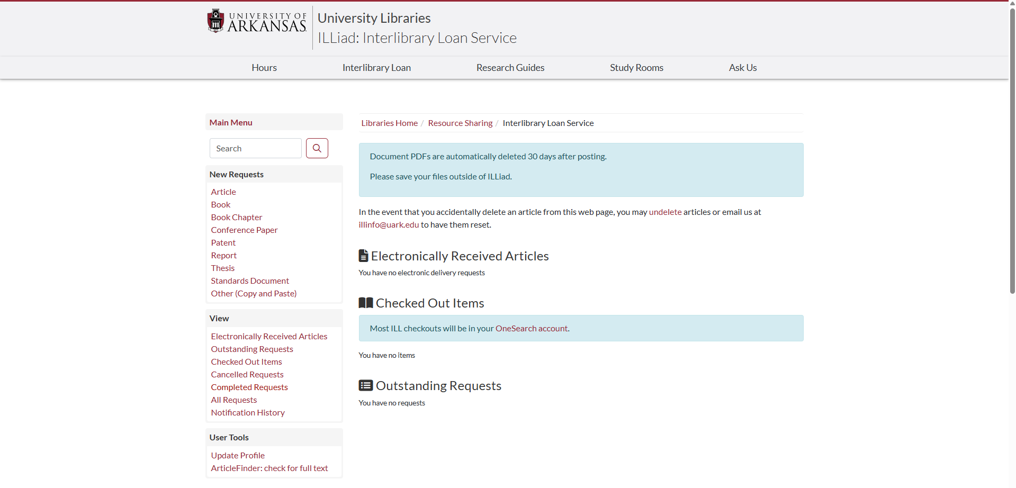
What You Can You See/Do in Your ILL Account
This section outlines the various request you can submit through ILL. Simply click on the request type you need, fill out the form, and submit.
Articles Received
Tip: Download your articles when you receive them because they are deleted from your account in 30 days.
Under this section you can view articles you have received, outstanding request that have not been filled yet, items you have checked out, cancelled requests, completed request, etc.
Items Currently Checked-out
Outstanding Request that have not been filled yet.

Slide 13
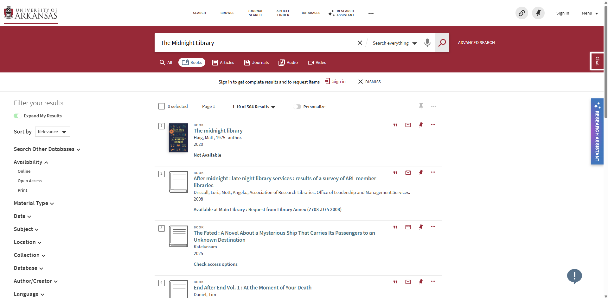

How to Place a Request: Step 1 Search the Library Catalog
Before Placing a request, it is always best to check the library catalog to make sure we don’t already own the item.
In some case, like the example to the left, we may own the item, but it is already check-out therefore you can proceed with requesting it through ILL.

Slide 14
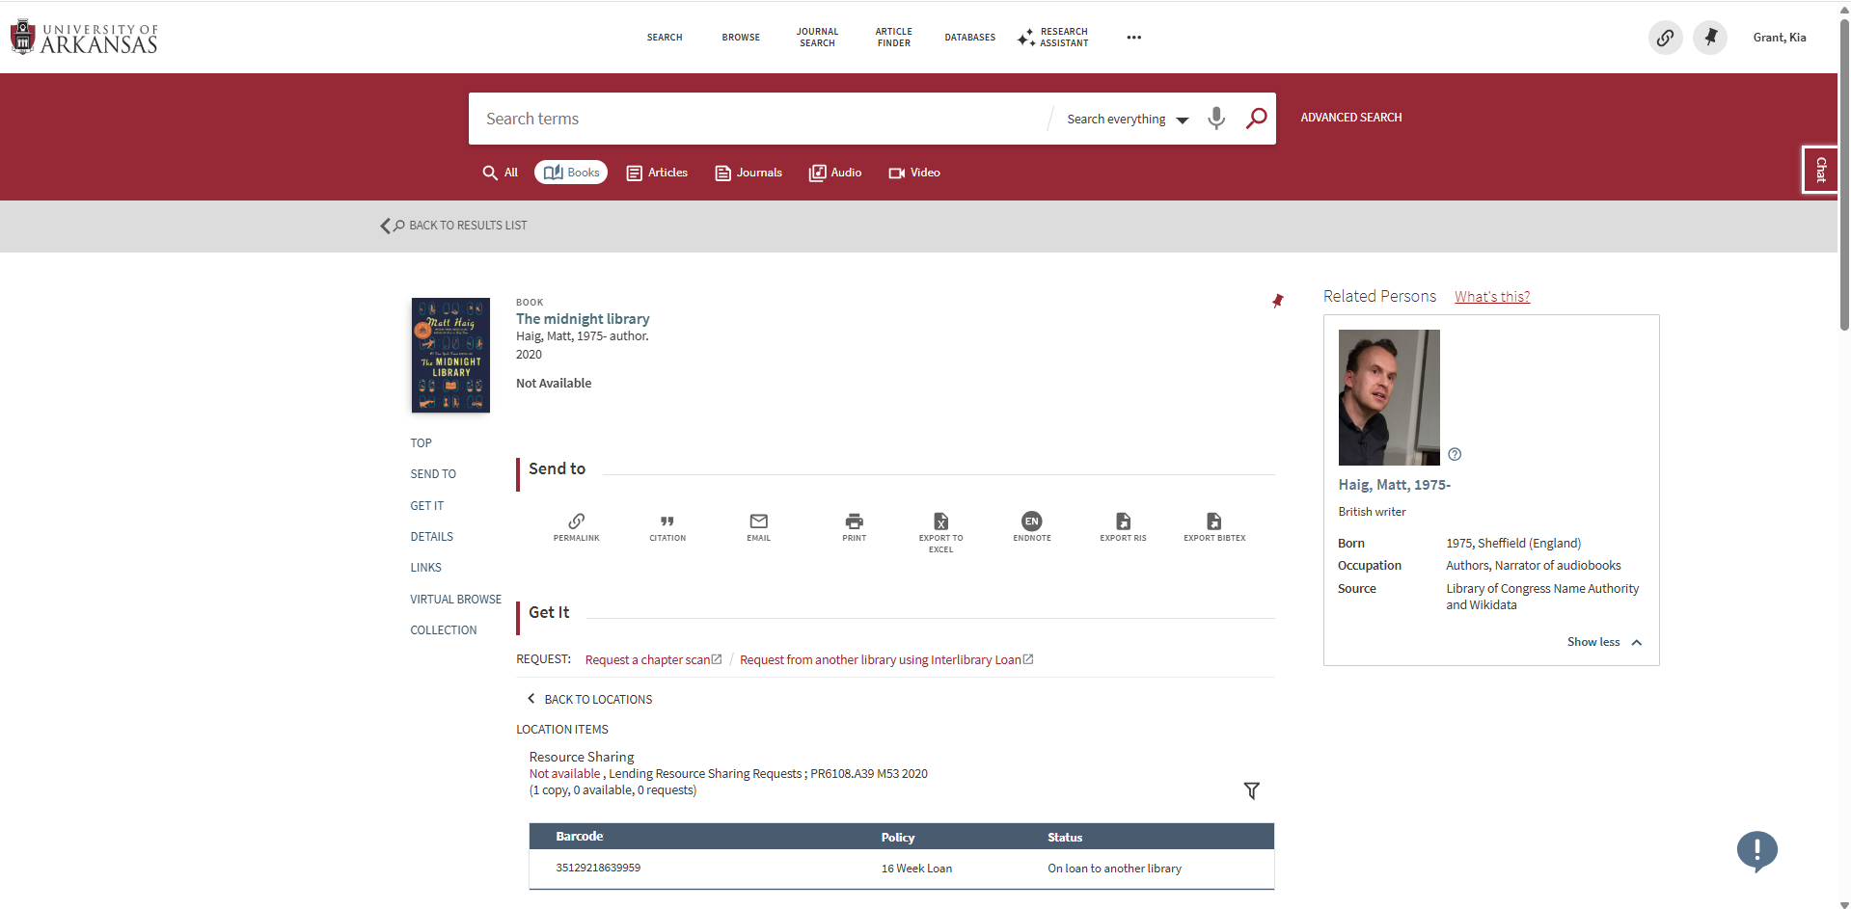
How to Place a Request: Step 1 Search the Library Catalog CONT.
If we own the item but it’s checked out you can click on the record in the catalog, then under the “GET IT” heading you can click on the Red LINK that says “Request from another library using Interlibrary Loan.” By clicking this link, it will route you to your ILL account. And the request form will be filled out for you.
If the item, you are looking for is not in the catalog at all you will have to go to your ILL account and manually enter the request information into the request form.

Slide 15
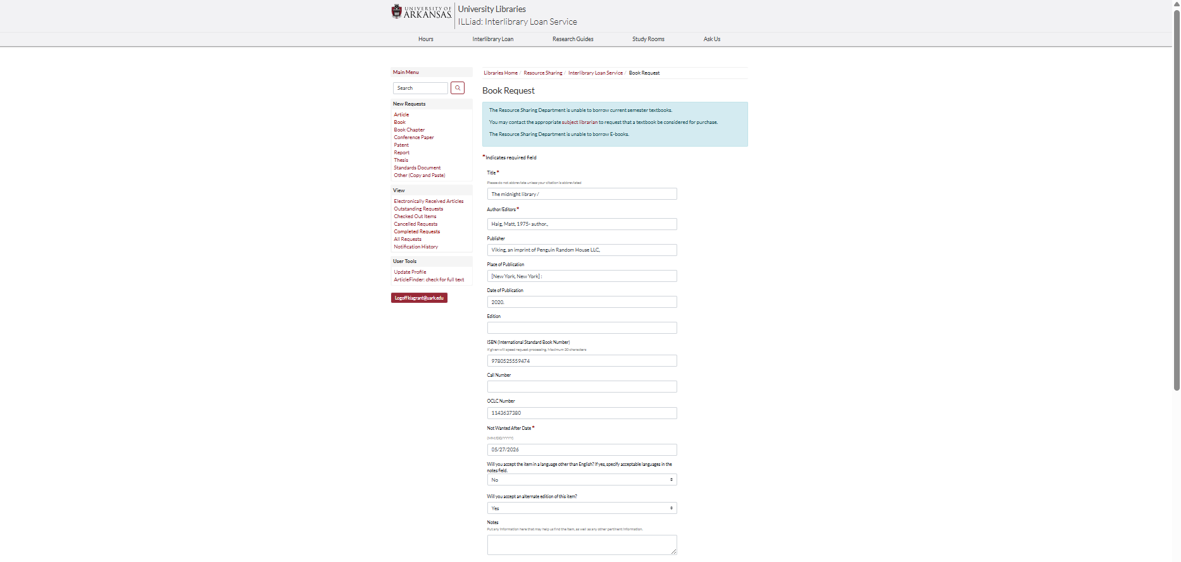
How to Place a Request : Step 2 Fill Out the Request Form
On the image to left you will see an example of what a filled-out book request form looks like.
For a quicker turn around time, it is important to fill out as much detail as you can so that we can quickly send it out to other lenders. Incomplete request may cause a delay due to verifying the citation.
Once all the information is filled out you can hit submit and wait to be notified via email when the item arrives.

Slide 16
How to Place a Request *Bonus*: Addressing Accessibility Needs
Our department is committed to ensuring that all patrons have equitable access to various materials and services.
Accessible Services Include:
Alternative format request such as: OCR enabled pdfs, large print or high contrast print versions, extended loan periods, and flexible pick-up options.
If you need us to make any accessibility accommodations, you can leave us a note in the request form to let us know what accommodations you need, contact us by email ILLinfo@uark.edu, phone 479-575-5311, or stop by our office RM 212 in Mullins.
Please note that there are limitations to services accessibility services we can provide in the case of non-English or low quality scans. For additional assistance under those circumstances, you can contact the Center for Educational Access https://cea.uark.edu/resources/software/ for other options.
You can leave any request or questions about accessibility accommodations here.

Slide 17
Turnaround Times
Articles
Books
International Materials
1-3 Days Business Days
3-7 Business days
1-2 weeks

Slide 18

How to Retrieve Your Materials
Article/ Chapter Scans | Articles and Chapter scans can be retrieved through your ILL Account .
Books | Books can be retrieved in Mullins via the pick-up lockers or the hold shelf in the ILL office.
Campus Delivery (Faculty) | If you are a faculty member and have opted to receive Campus Deliveries from us we will drop the item off at your office or mailbox.

Slide 19
How Long Can You Keep These Items?
Articles/Chapter Scans
Books
DVDs and Media
Articles and chapter scans are held in your ILL account for 30 days.
Books are usually loaned for about 16 weeks. Can request a renewal if the lending library allows.
DVDs and other media are typically loaned for 2-4 weeks. Renewals may be allowed if authorized by the lending library.

Slide 20
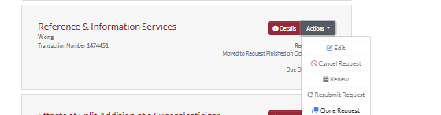
Managing Your Requests
If you click on the ‘Actions’ button on the side of your request. It gives you several options to manage your request.
Edit
Cancel
Renew
Resubmit Request
Clone Request

Slide 21
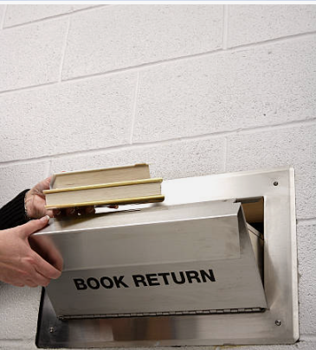
Returning Your Loans
Books can be returned at:
The return boxes by the library’s entries.
At the help desk on the 2nd floor.
Directly to the Resource Sharing Office in RM 212
Some of the items we receive are fragile, so they will have to be returned directly to the help desk or the ILL office.

Slide 22
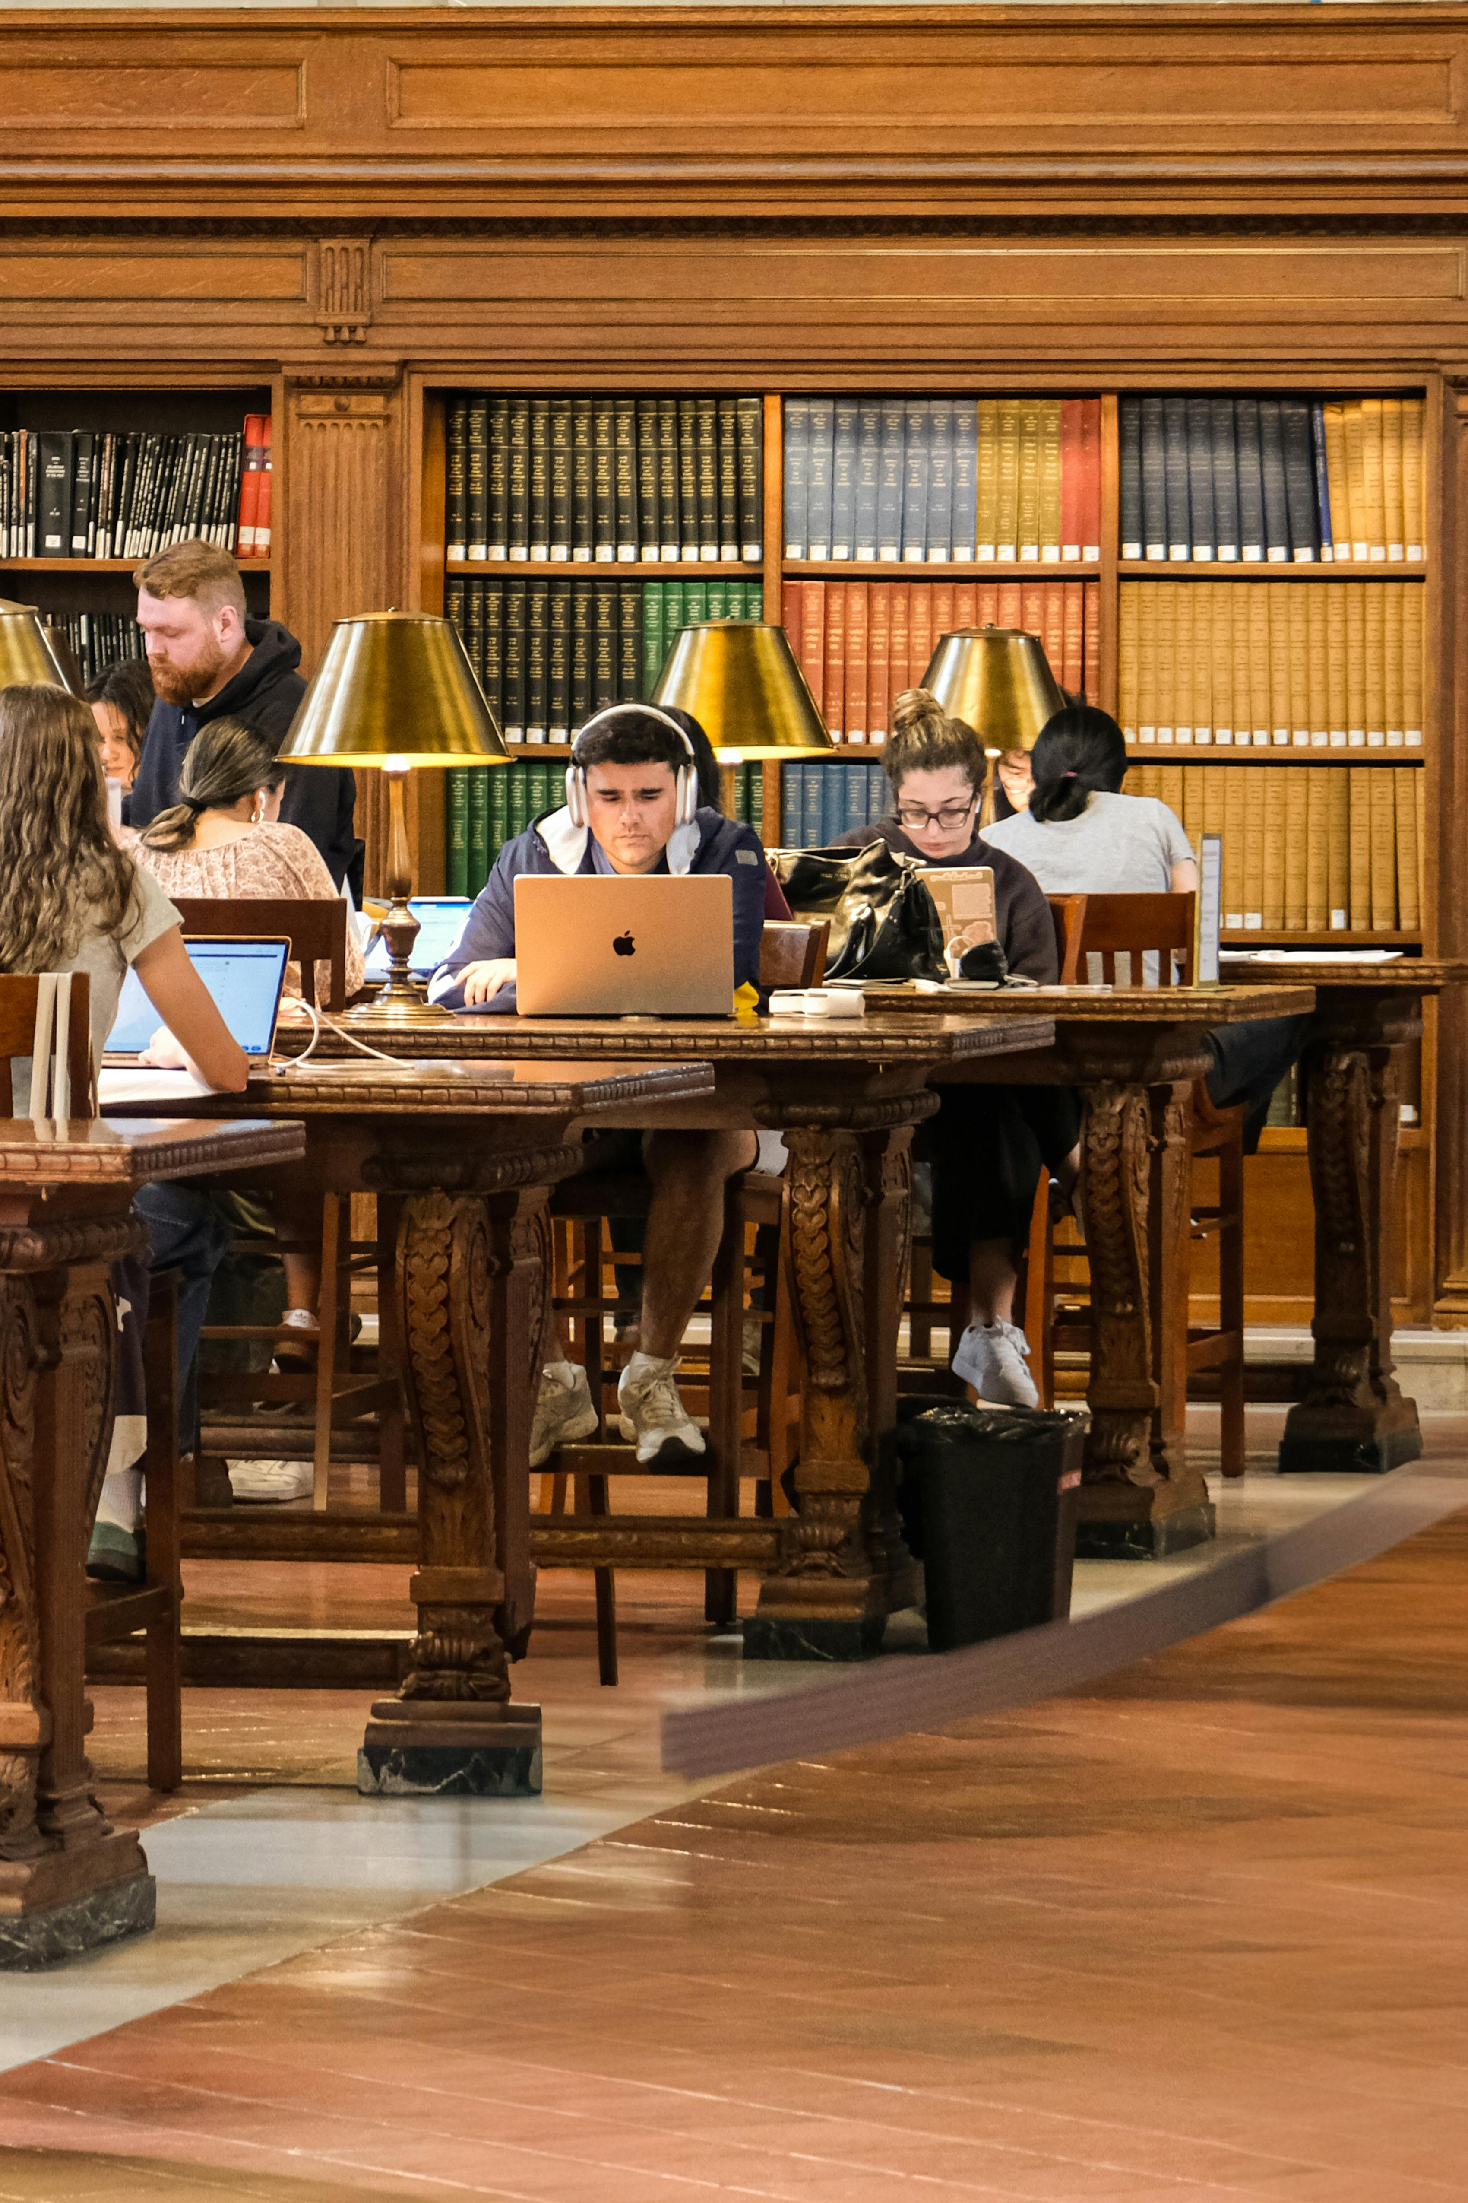
Bonus: Resource Sharing Tips, Policies & Best Practices
04

Slide 23
The DOs and DON’Ts of Resource Sharing
DO
DON’T
Request items early
Double-check our catalog
Provide complete citations
Pick-up and Return items promptly
Ask if you are unsure
Wait until the night before your paper is due.
Request required textbooks.
Damage, highlight, or mark up borrowed books.

Slide 24
THANKS For Using Our Services
If you have any further questions please reach out:
illinfo@uark.edu| 479-595-5311 | Resource Sharing Department RM 212 of Mullins Library
Office Hours:
M-F: 8:00 am -5:00 pm

